Slide 1



Thesis Progression Committee – Meeting 1
Oluwatosin Olatunde Alabi
27th October 2023
Supervisors: Professor Tom Vercauteren, Prof. Miaojing Shi

Slide 2
PhD Outline
Title: Exploiting Multi-task Learning for Endoscopic vision in Robotic Surgery
Timeline: 01/10/2022 – 01/10/2026
Aims :
  Learning appropriate surgical vision models with multitask learning to perform better than learning each task independently.
  Learning appropriate surgical vision models with Multitask learning and Limited Supervision to perform as well as Multitask learning with adequate supervision
  Advancing the state of art by combining depth estimation, optical flow estimation, with surgical instrument detection, anatomy recognition, and surgical action recognition.
  Evaluating and validating Endoscopic Vision based learning paradigms

Slide 3
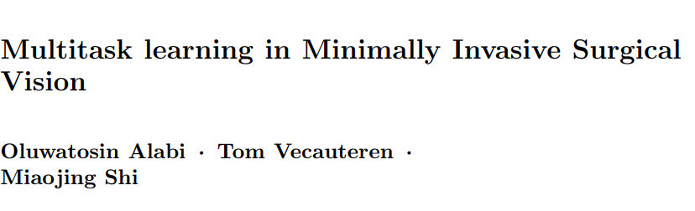
Current Work

Slide 4
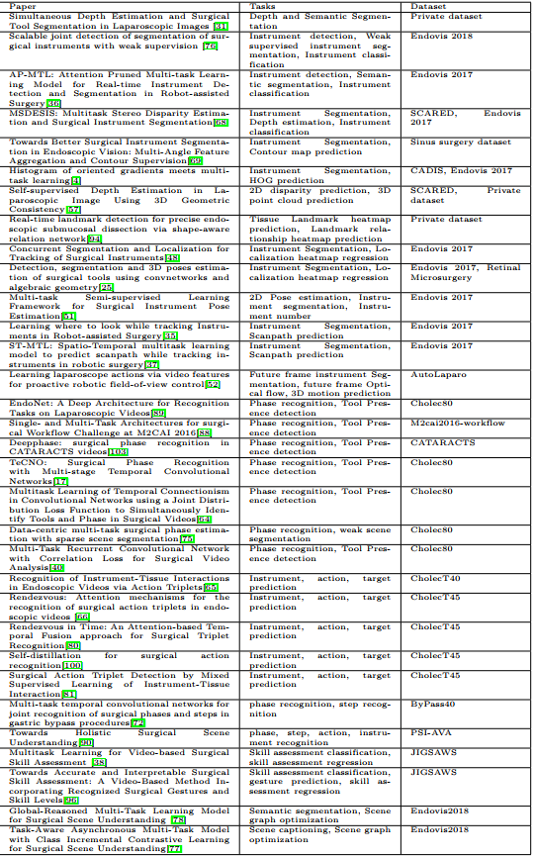
Limited to surgical vision and minimally invasive surgeries,
There should be multiple tasks as outputs
32 papers reviewed in depth.

Slide 5
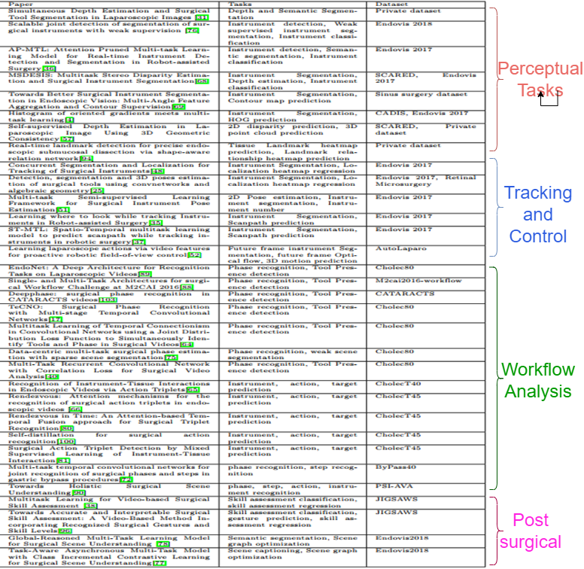
Paper subdivisions
Multitask learning for Perceptual tasks
Multitask learning for Tracking and Control
Multitask learning for Surgical video workflow analysis
Multitask learning for Post-surgical analysis

Slide 6
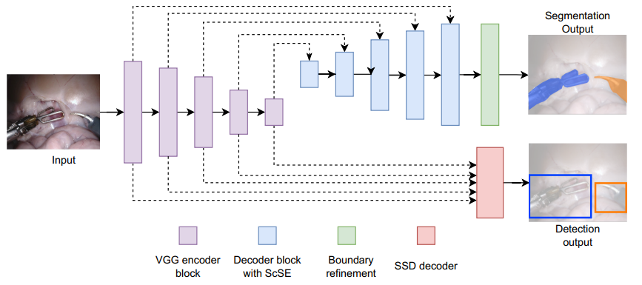
Multitask learning for Perceptual tasks
Division
Learning of multiple perceptual tasks together
Usage of Auxiliary tasks
Conclusions
Some positive results but there is the presence of negative transfer
Single encoder multiple decoder architecture was the default, more communications between decoders in more recent works
Optimization approach is usually linear scalarization.

Slide 7
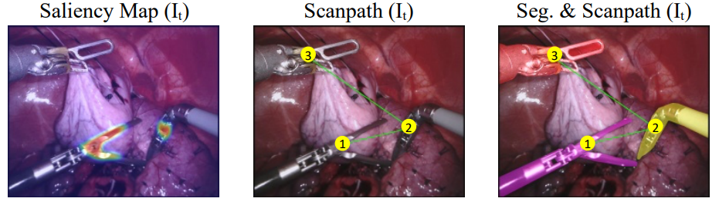
Multitask learning for Tracking and Control
Division
Pose Estimation
Scanpath tracking
Camera Imitation learning
Conclusions
2D pose estimation instead of 3D pose estimation is common
Motion prediction difficult

Slide 8
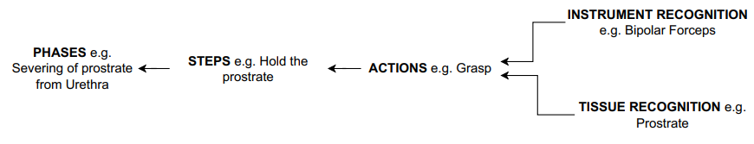
Multitask learning for Surgical video workflow analysis
Division
Auxiliary Tasks
Surgical Triplets
Multi-granularity Activity Recognition
Conclusions
Dataset availability affects research. Phase detection > Triplet > Multigranularity
Understanding of complex interactions. Triplet and multigranularity

Slide 9
Multitask learning for Post-Surgical Analysis
Division
Report Generation
Skill Assessment
Conclusions
We are still at initial stages for the Report Generation task – Image Captioning

Slide 10
To Complete the review paper
Addition of large models which use prompts to perform multiple tasks. (More on this later)
Finishing touches to ensure it can get submitted as a publication

Slide 11
Other Explorations

Slide 12
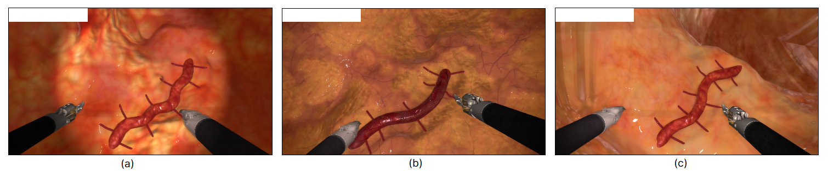
Synthetic data for Instrument Segmentation in Surgery (SynISS) Challenge Participation
Training data and rules
Train on instrument segmentation using synthetic datasets and test performance on synthetic datasets.
Submissions would be tested on datasets from the same virtual reality simulator tasks and Procedures.
Aim is to apply segmentation methods on our synthetic dataset and obtain high performance.
 | Dataset 1 | Dataset 2
No. of scenes | 1 | 3
No. of samples | 1200 | 1800

Slide 13
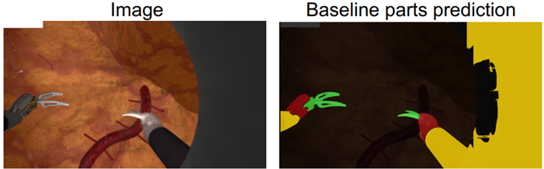
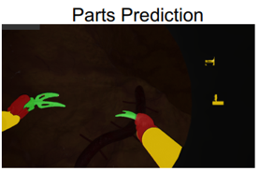
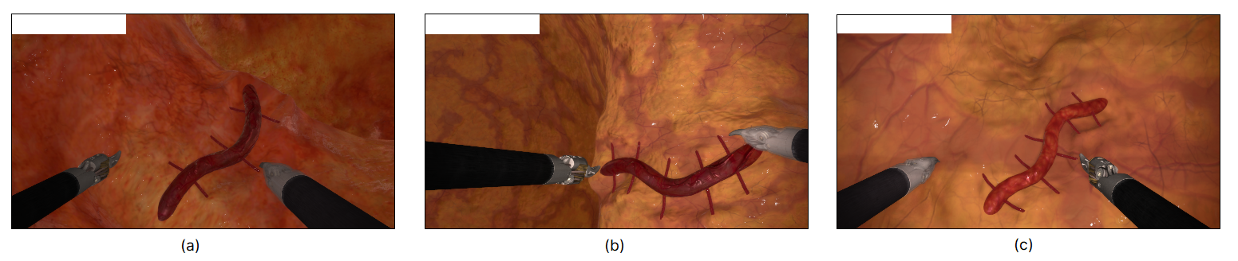
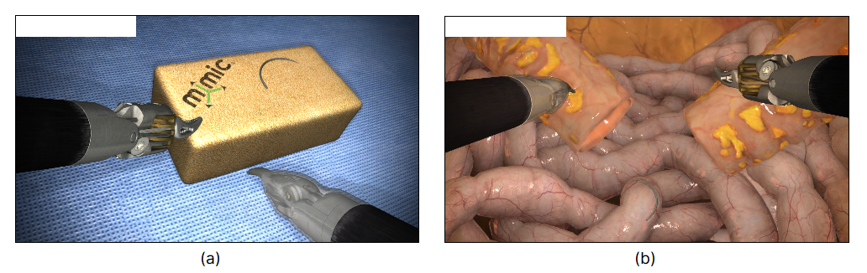
SynISS Challenge Conclusion
Standard U-Net was used with Trocar Augmentation
Test Dataset contained information from different procedures and task
Winning solutions utilized large models which had been pretrained on large amounts of data
Conclusion
Large models with a lot of pretraining generalize better.

Slide 14
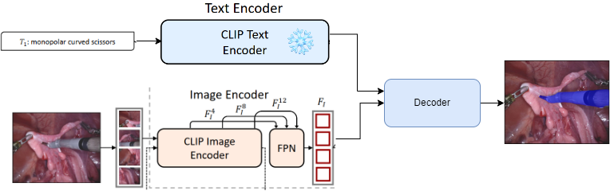
Text Promptable Surgical Instrument Segmentation with Vision-Language Models
Text prompting for instrument segmentation. Hence you could combine binary segmentation, parts segmentation, instrument-type segmentation and cross-dataset segmentation.

Slide 15
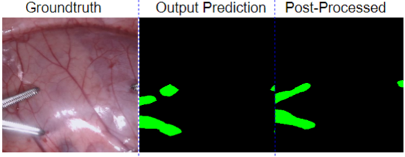
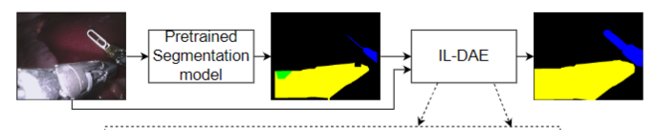
Image-guided Label Denoising Autoencoder for Surgical Instrument Segmentation Post-Processing (IL-DAE)
The idea came from studying the error modes for segmentation models I had developed.
Essentially, I wanted to be able to take an almost correct segmentation and produce a better result
I wanted something that could do this for any dataset i.e Train a single IL-DAE for all instrument datasets. Hence I devised a training scheme to deform labels and train a model to predict the non deformed labels.

Slide 16
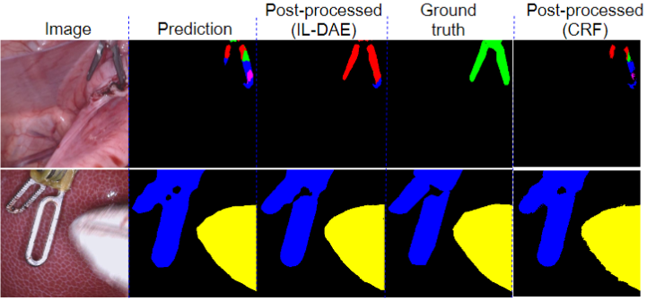
ILDAE Conclusion.
It worked all the time as expected, but only minimally improving by 1 or 3 percentage points, worked better than basic CRF hand tuned.
It was hard to sell adding a second network(Used U-Net) for just a few points improvement.
Rejected AECAI

Slide 17
Conclusion from all the explorations
Do better work.
Focus more on PhD topic.

Slide 18
Next Work

Slide 19
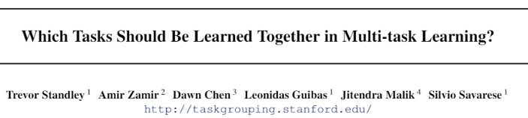
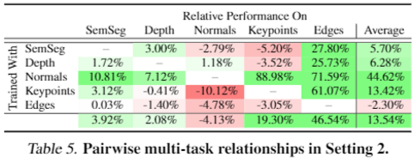
Toward March for MICCAI 2024(4-5 months)
A follow up to the Review (which tasks help each other under different conditions)

Slide 20
Toward March for MICCAI 2024(5 months)
A follow up to the Review (which tasks help each other in minimally invasive surgeries under different conditions)
Take 5 minimally invasive tasks(e.g Detection, Segmentation, Counting, Action recognition, and monocular depth) similar to the 2020 papers and check which tasks improve performance when trained together, under different conditions.
  Think of something with massive data.
  Theoretical framework – Think about other things in this task. Think as a task as a function. What are the inputs for each settings.
  Bishop 2006, Multitask learning section. Theoretical point of view.
Also need to compare against pretrained large models which are finetuned for a single tasks and/or multiple tasks(Text promptable needs to be extended for different types of outputs).

Slide 21
Pros for this task
Most Published papers in MICCAI present two task interactions. We would be presenting multiple task interactions.
It would be a Logical conclusion and companion work for the review paper
It would be an interesting read
I would use Large Models.
If I can solve the extending of large model to multiple tasks this is publishable on its own. But If this is taking too much time it is not necessary for publication.
It is a safe work.

Slide 22
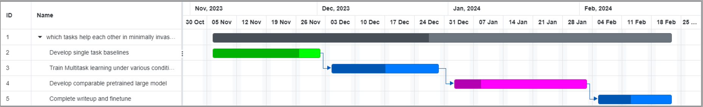
Gantt Chart for November to March

Slide 23
Plans for after March 2024

Slide 24
March 2024 till September 2024
It will depend on my performance over the next 5 months.
If I impressive, I would like to take on a tough and impactful challenge, gear my PhD towards solving that particular problem.
If I am less than Impressive, I would have to take on another safe challenge and be successful. Before taking on a more tough and impactful challenge.

Slide 25
Possible impactful challenges
Multigranularity and Multitask prediction for workflow.(I think triplet is under this task)
Motion prediction for Endoscopic Cameras.
More on large models, a General visual intelligence network.
Need to discuss this with Tom and Miaojing when the time comes.

Slide 26
Thank You

